Slide 1
Lesson 6 Personal Computer
任课教师：刘昱朗
Email: yulangliu@hotmail.com

Slide 2
Outline
Technical Contents
Hardware 硬件
Operating system (OS) 操作系统
Software 软件
Technical Terms

Slide 3
Main components
Users' Files
Software
OS
Hardware

Slide 4
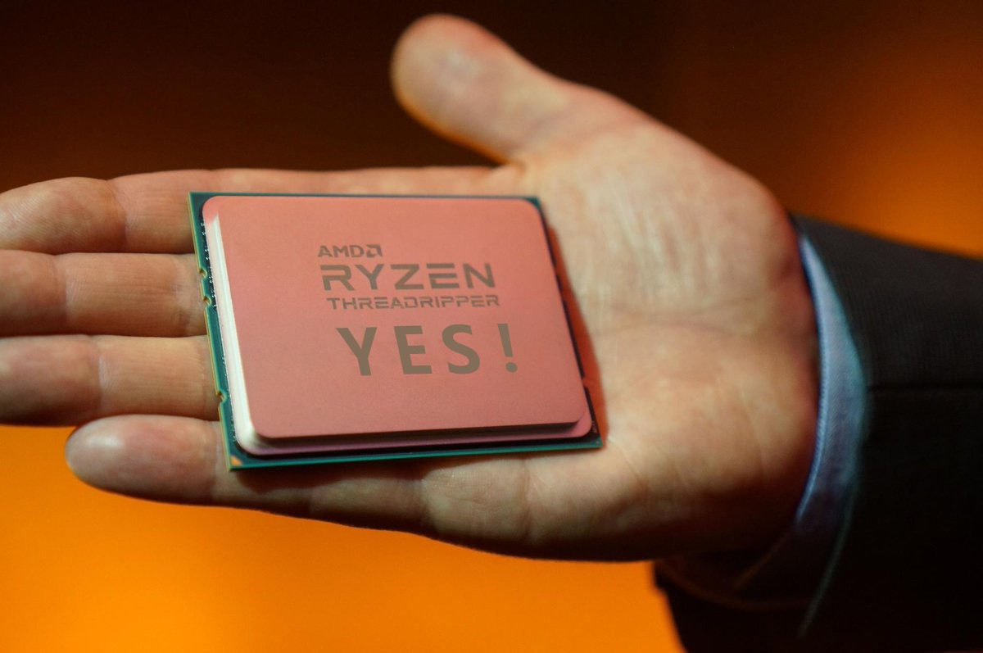
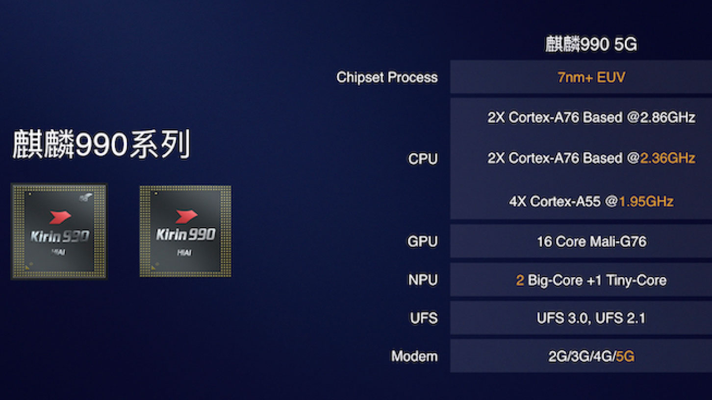
Hardware
CPU - central processing unit
Makes decisions, performs computations, and delegates input/output requests

Slide 5
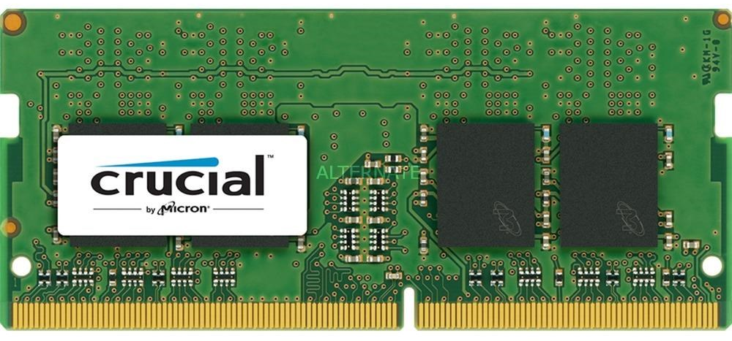
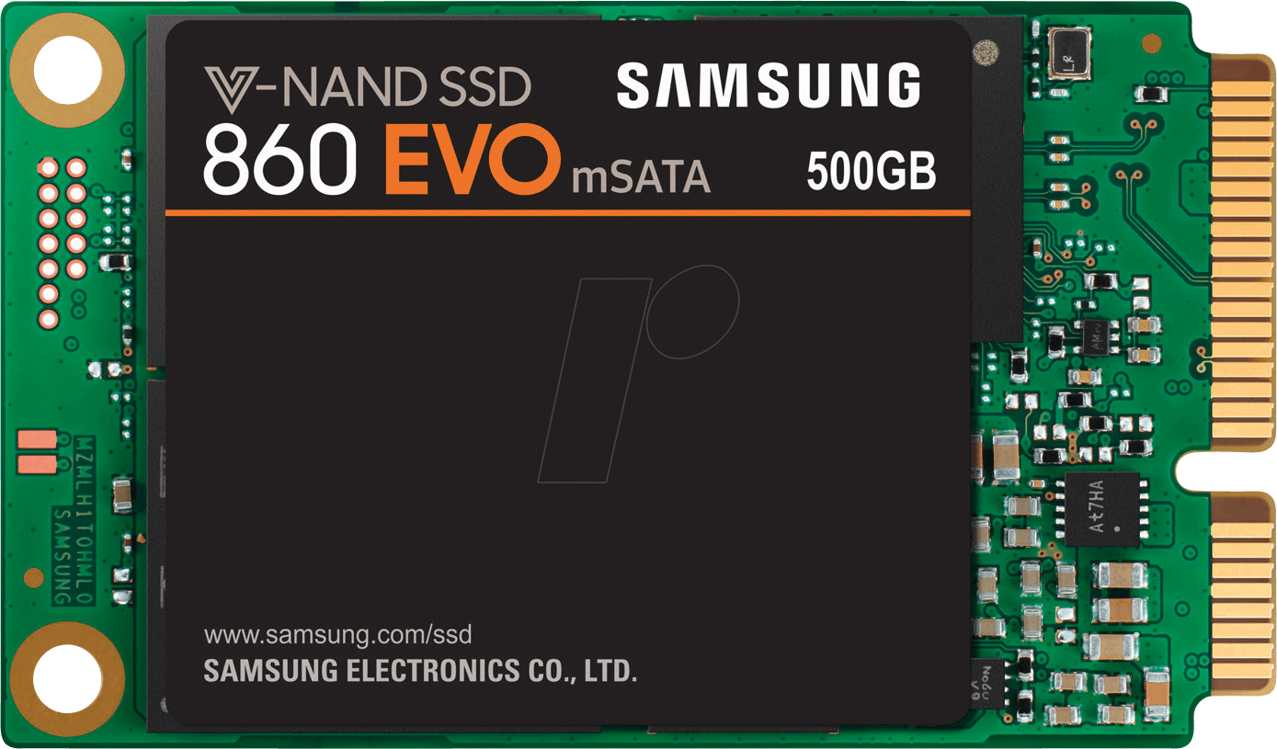
Hardware
Memory:
RAM(Random Access Memory) :
ROM(Read Only Memory) : HDD，SSD

Slide 6
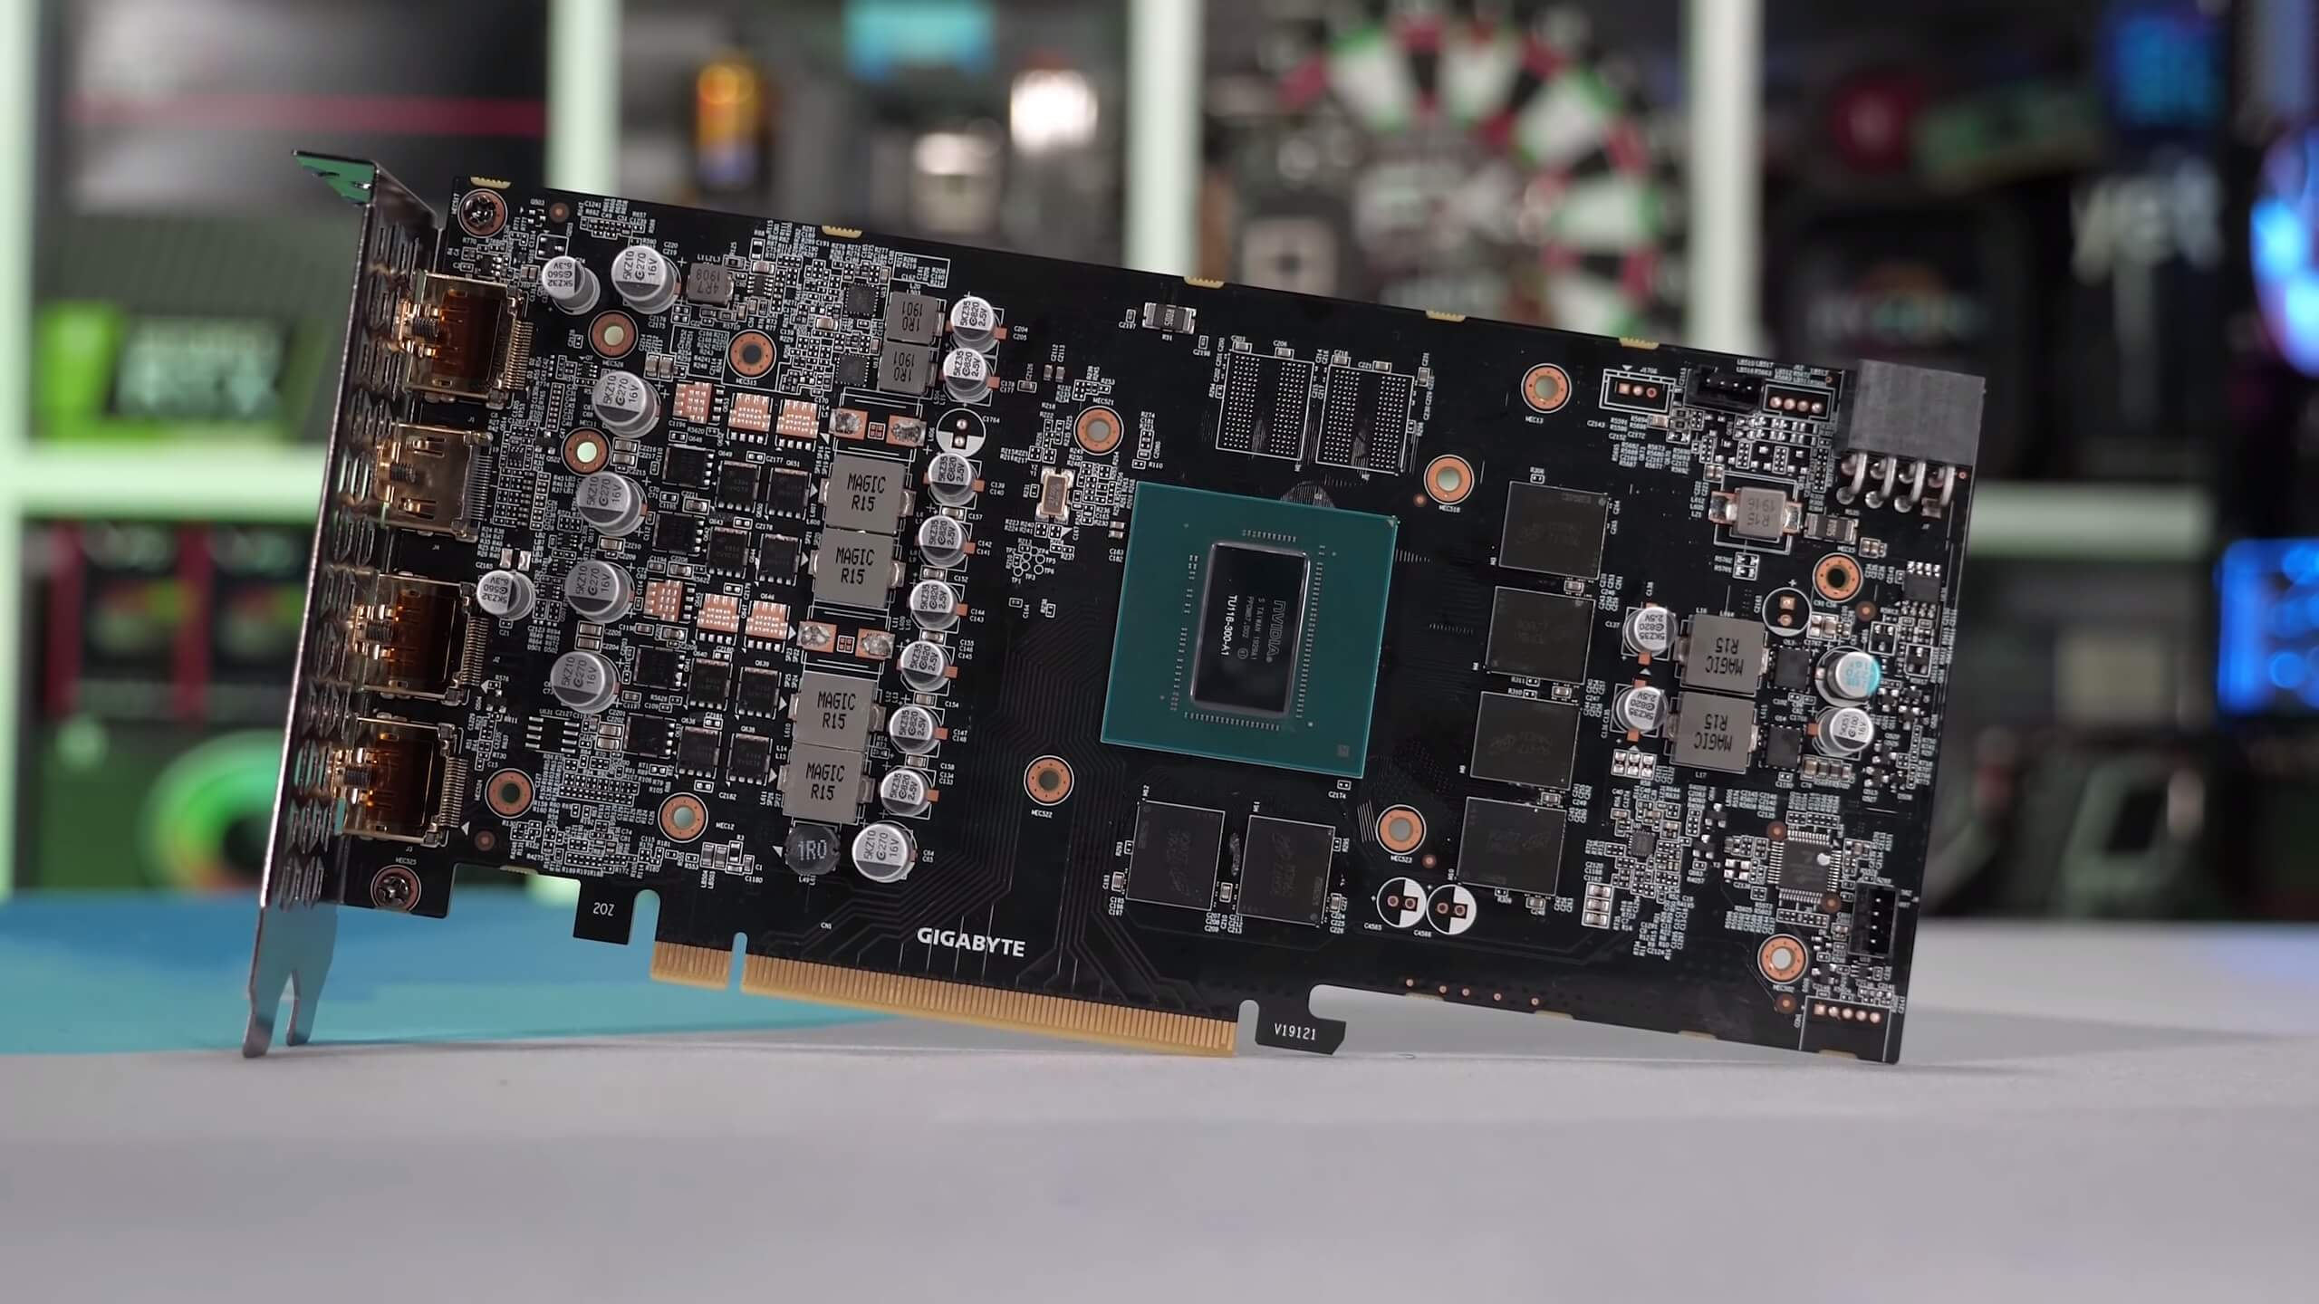
Hardware
GPU: Graphics Processing Unit

Slide 7
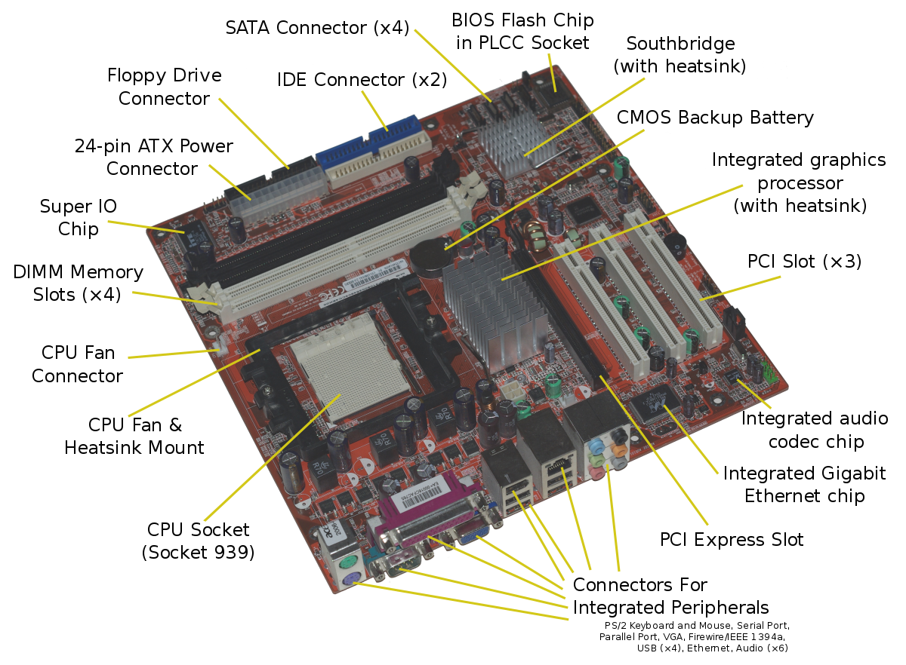
Hardware
Motherboard: holds, and allows, communication between many of the crucial electronic components of a system

Slide 8
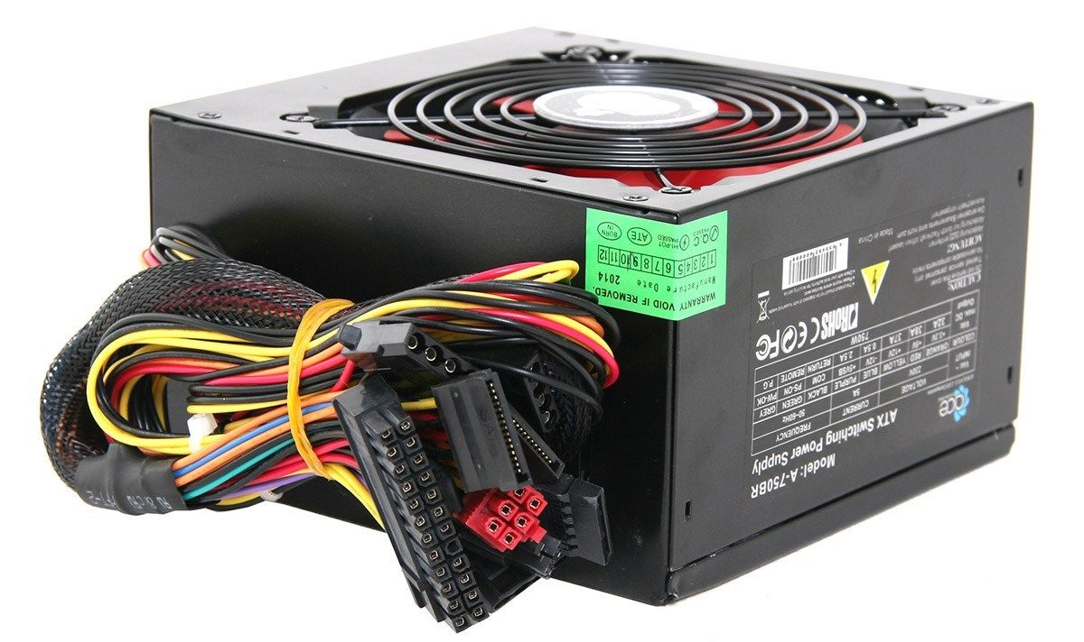
Hardware
Power Supply

Slide 9

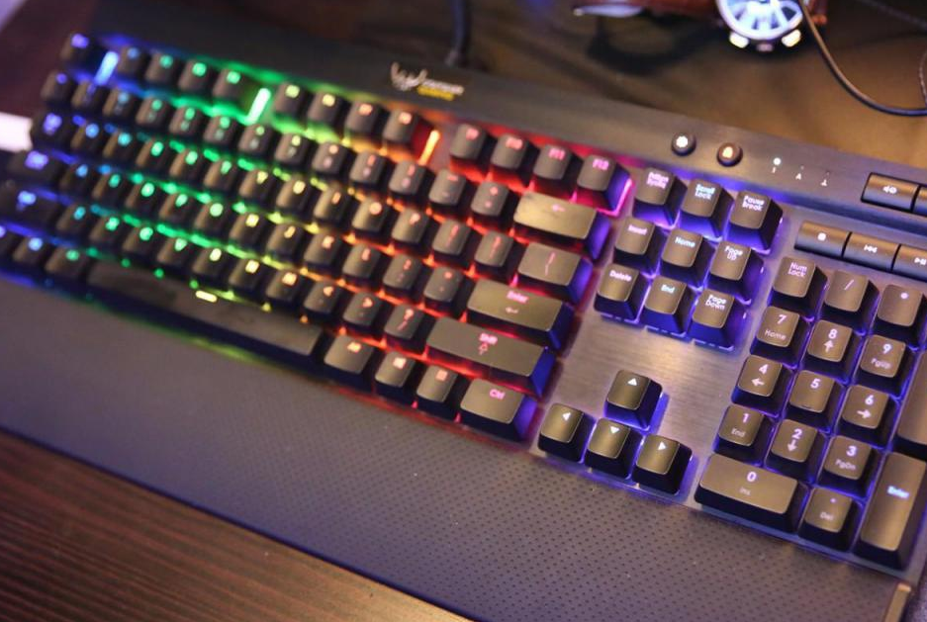
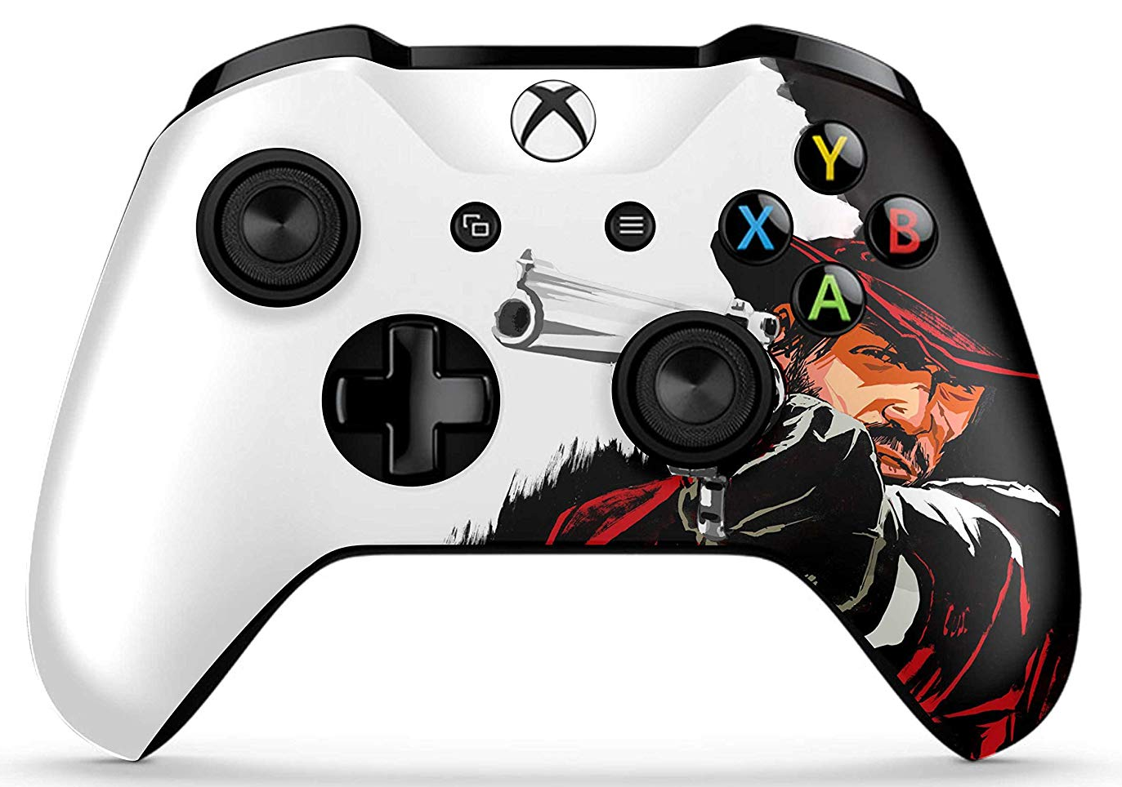
Hardware
Input devices: Keyboard, Mouse, Controller
Gets information from the user to the computer

Slide 10
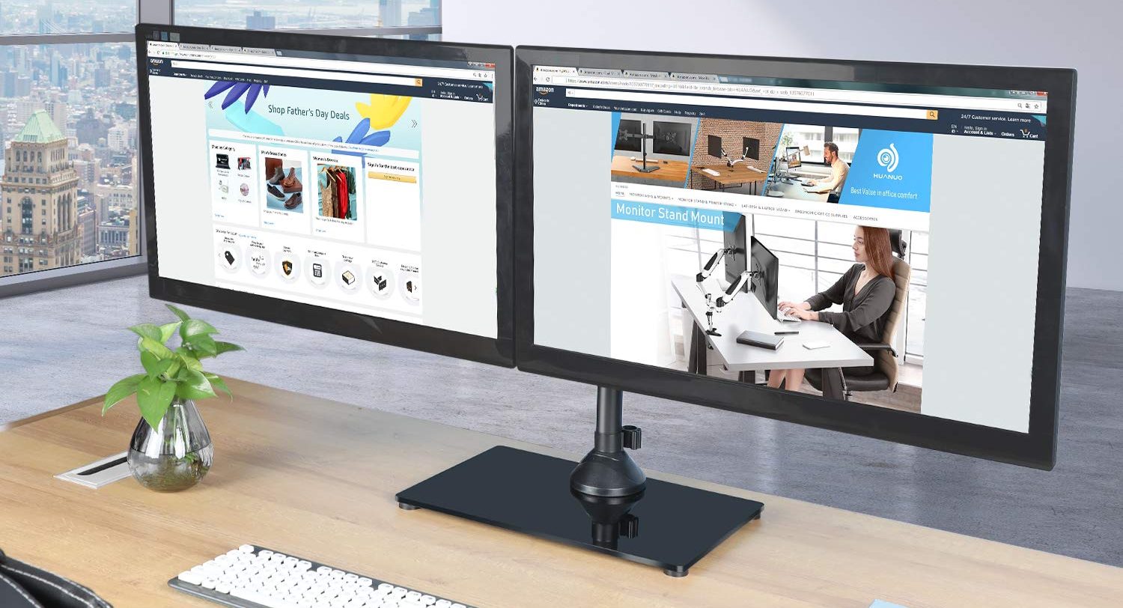
Hardware
Output devices: Monitor

Slide 11
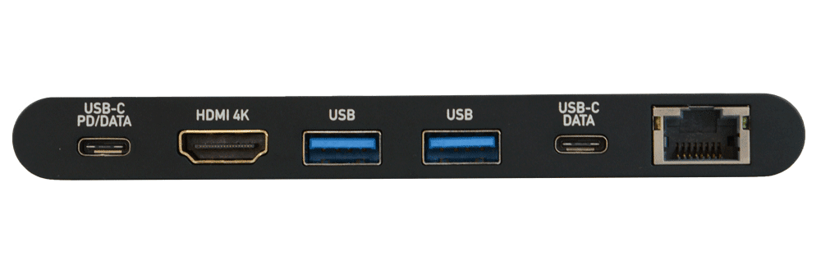
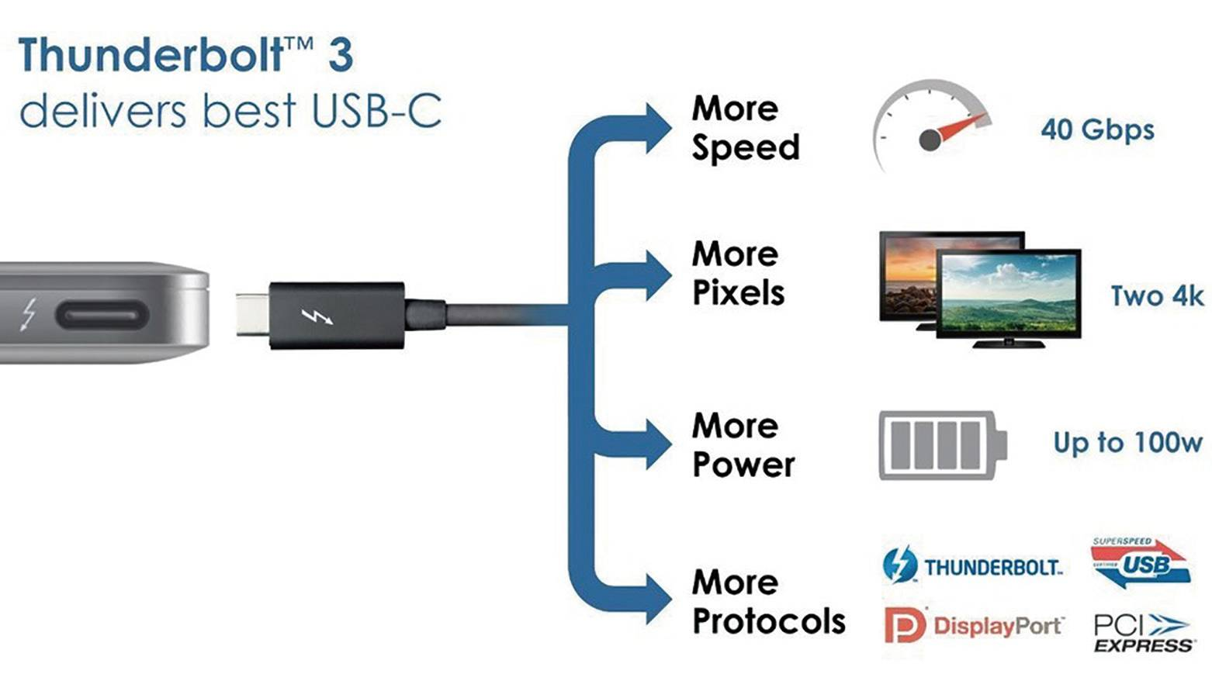
Hardware
Ports

Slide 12
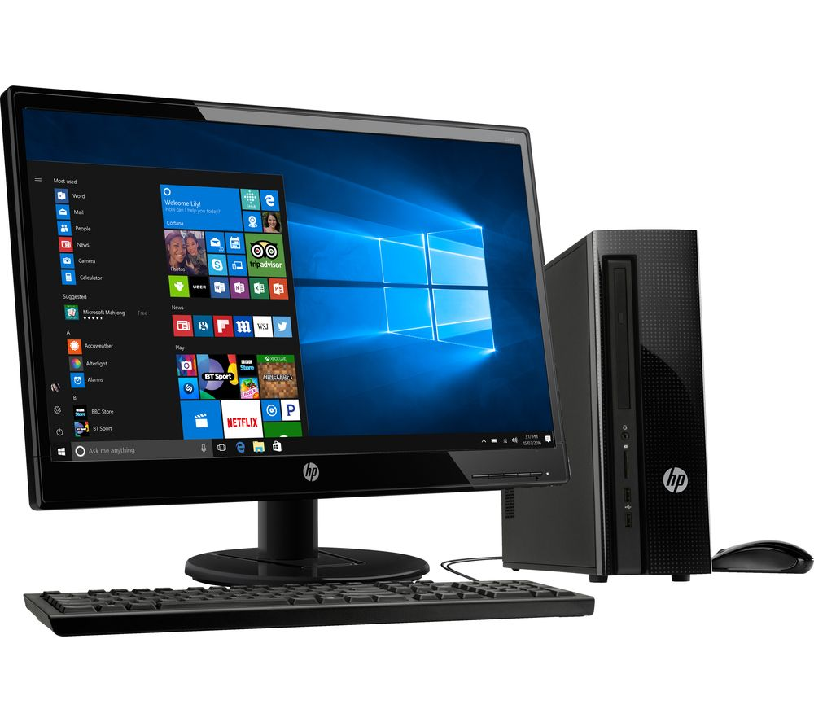
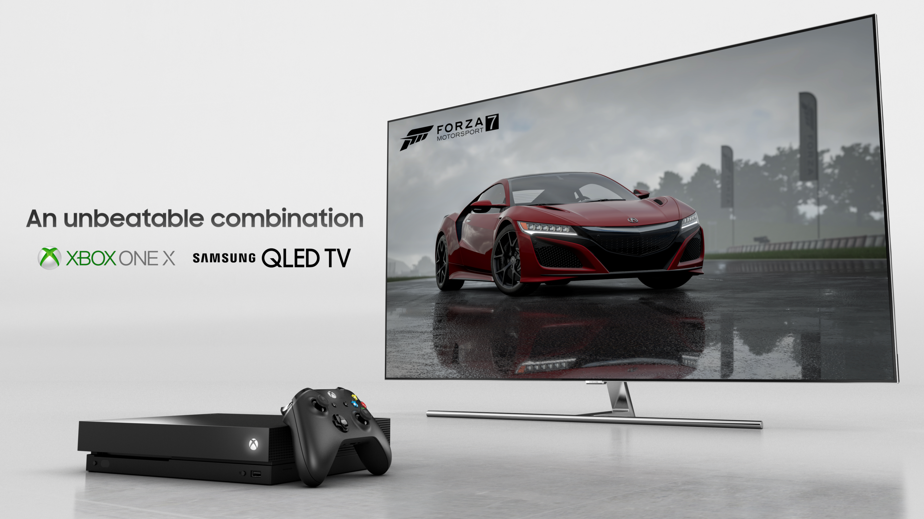
Personal Computer

Slide 13

OS(Operating System)

Slide 14
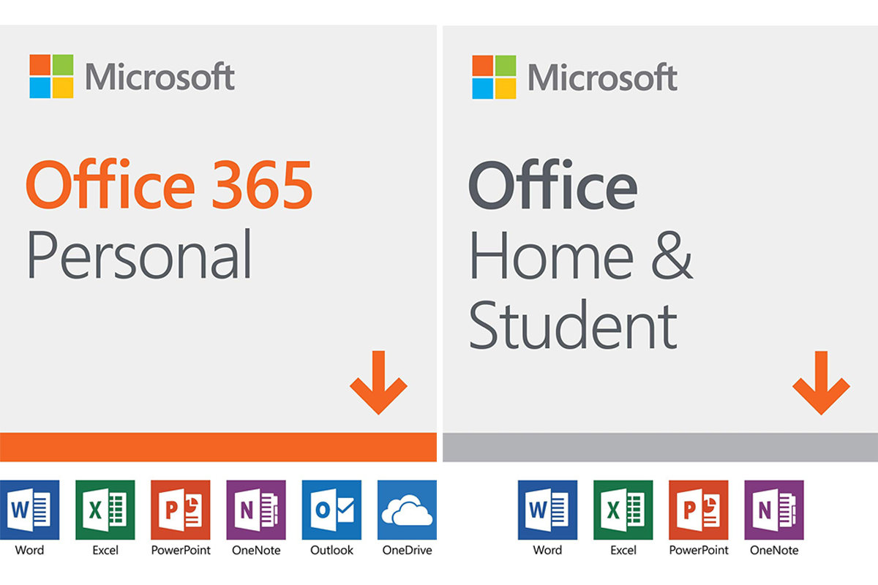
Software

Slide 15
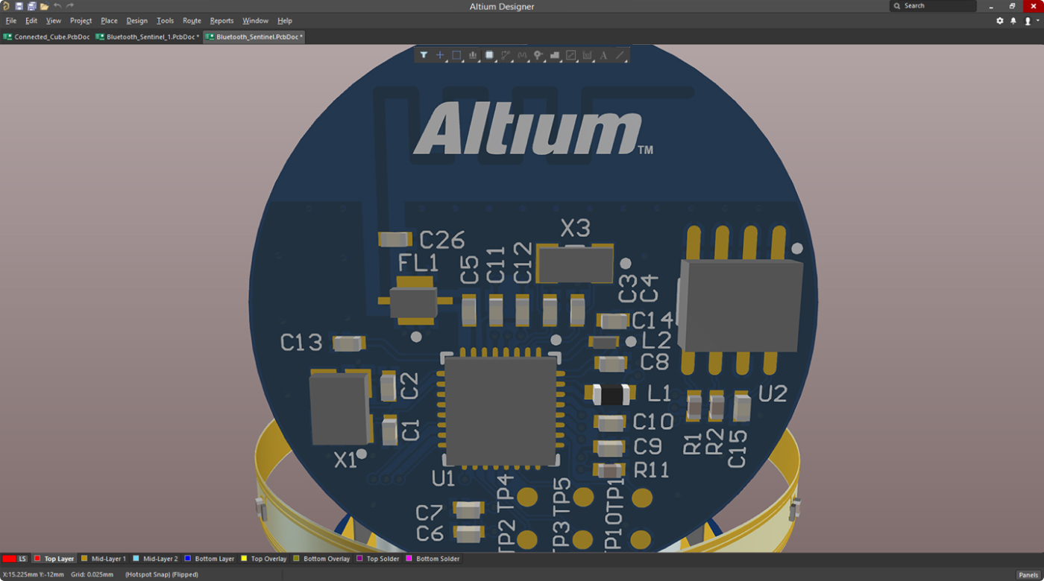
Software

Slide 16
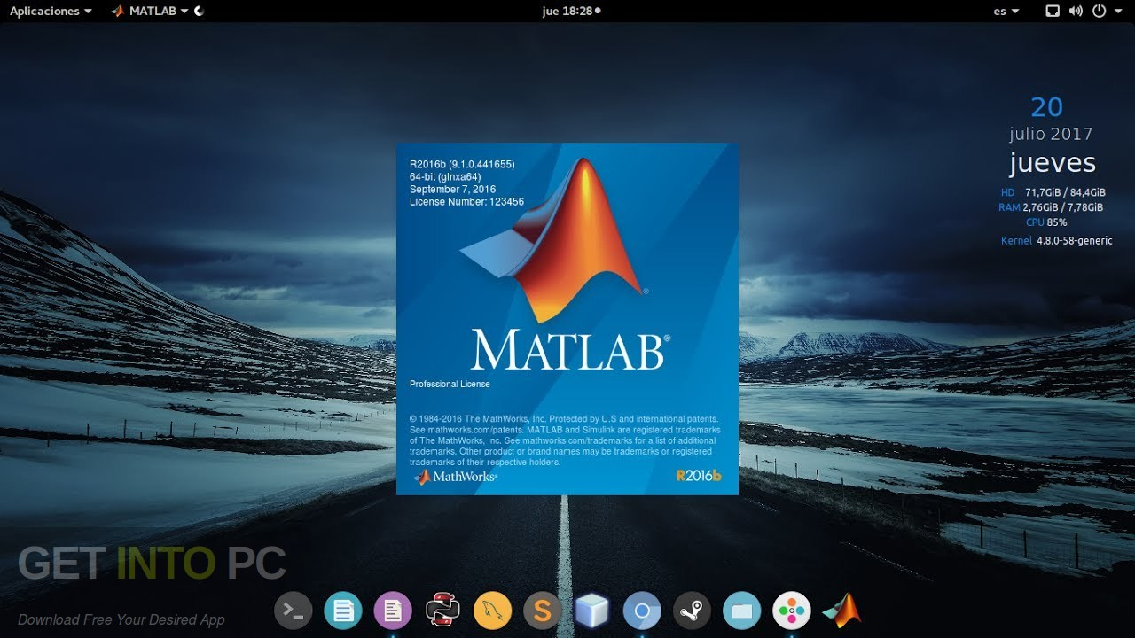
Software

Slide 17

Software

Slide 18
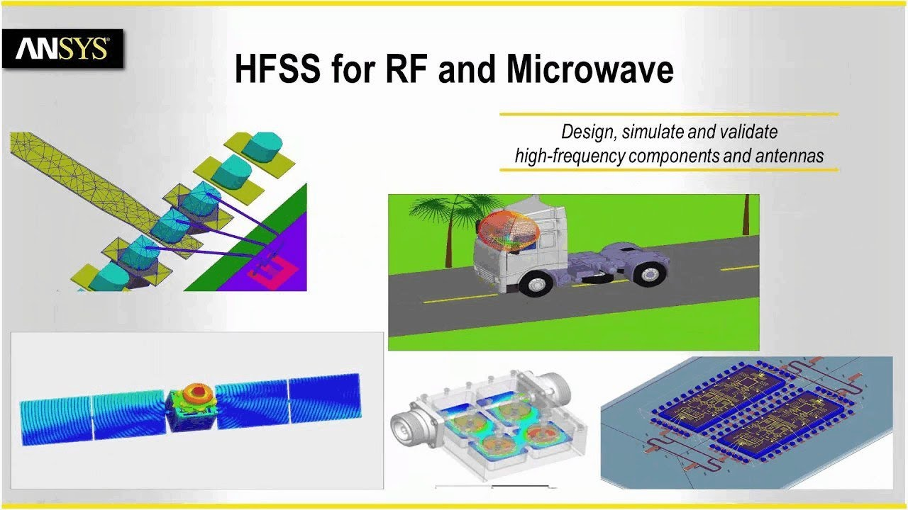
Software

Slide 19
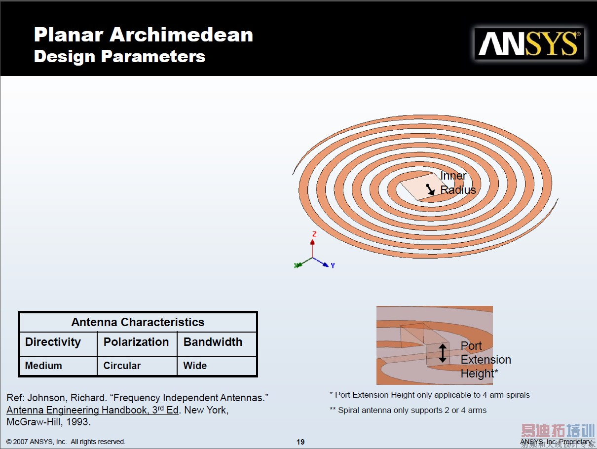
User
CAD: Computer Aided Design

Slide 20
Technical Terms
Graphics 图形
Cable 电缆
Sequence 顺序
Modem(modulator-demodulator) 调制解调
Desktop/Laptop 台式机/笔记本
Motherboard 主板
Monitor 显示器、监视器
Mouse 鼠标
Fiber 光纤
华为Mate30pro: 7680fps 超级慢动作拍摄

Slide 21
Technical Terms
User Interface 用户接口
PC Personal Computer
CPU Central Processing Unit
GPU Graphics Processing Unit
WAN Wide Area Network
USB Universal Serial Bus
HDMI High Definition Multimedia Interface
华为Mate30pro: 7680fps 超级慢动作拍摄

